Slide 1


Noida Institute of Engineering and Technology, Greater Noida
STEADY STATE ANALYSIS OF AC CIRCUIT
AIML/BT
Unit: 2
Kashika Baranwal
Assistant Professor
EN Department
Basic Electrical & Electronics Engineering
B.Tech 2nd Sem

Slide 2
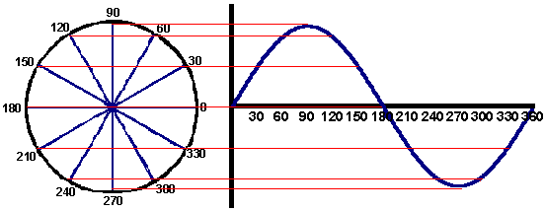
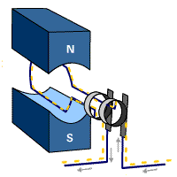
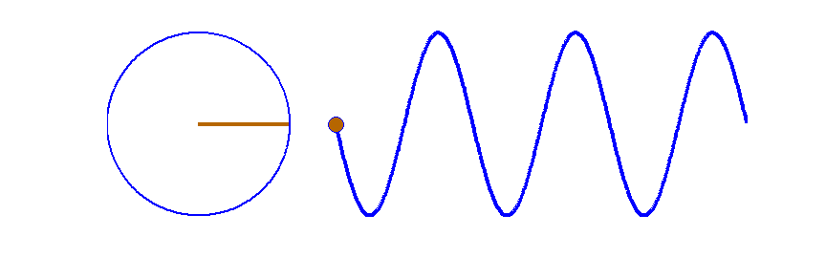
Generation of alternating voltage

Slide 3
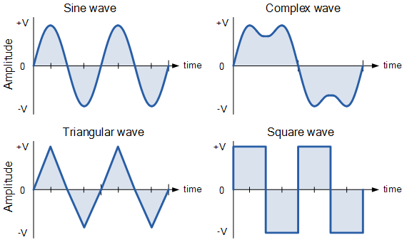
Types of Alternating Waveforms

Slide 4
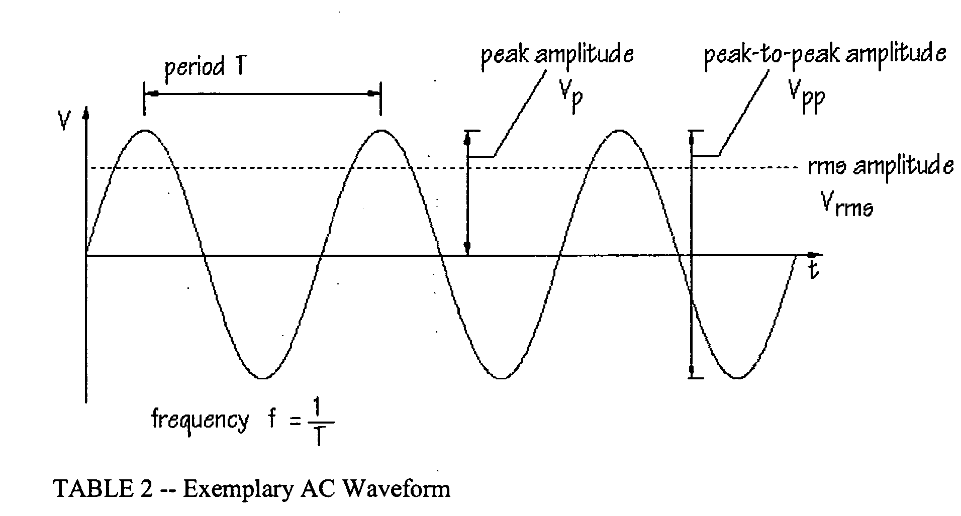
Standard Sinusoidal Wave
What is AC ?
Terminology
Waveform
Time Period
Frequency
Peak Value or Amplitude

Slide 5
AC Fundamentals (CO2)
Alternating Waveform: The waveform which changes its magnitude continuously and direction at regular interval of time.
Time Period (Sec): The minimum time required to complete one cycle is known as time period.
Frequency (Hz): The number of cycle completed in one second is called as frequency. (Angular Frequency, ώ =2πf)
Note: In general, a.c quantities are represented by their rms values (or effective values)

Slide 6
AC fundamentals (CO2)
Que. An Alternating current of frequency 60 Hz has a maximum value of 15 Amp.
Write down the equation for instantaneous value
Find the value for current after 1/200 seconds
Find the time taken to reach 10 Amp for the first time
i=Im Sin wt
v=Vm Sin wt

Slide 7
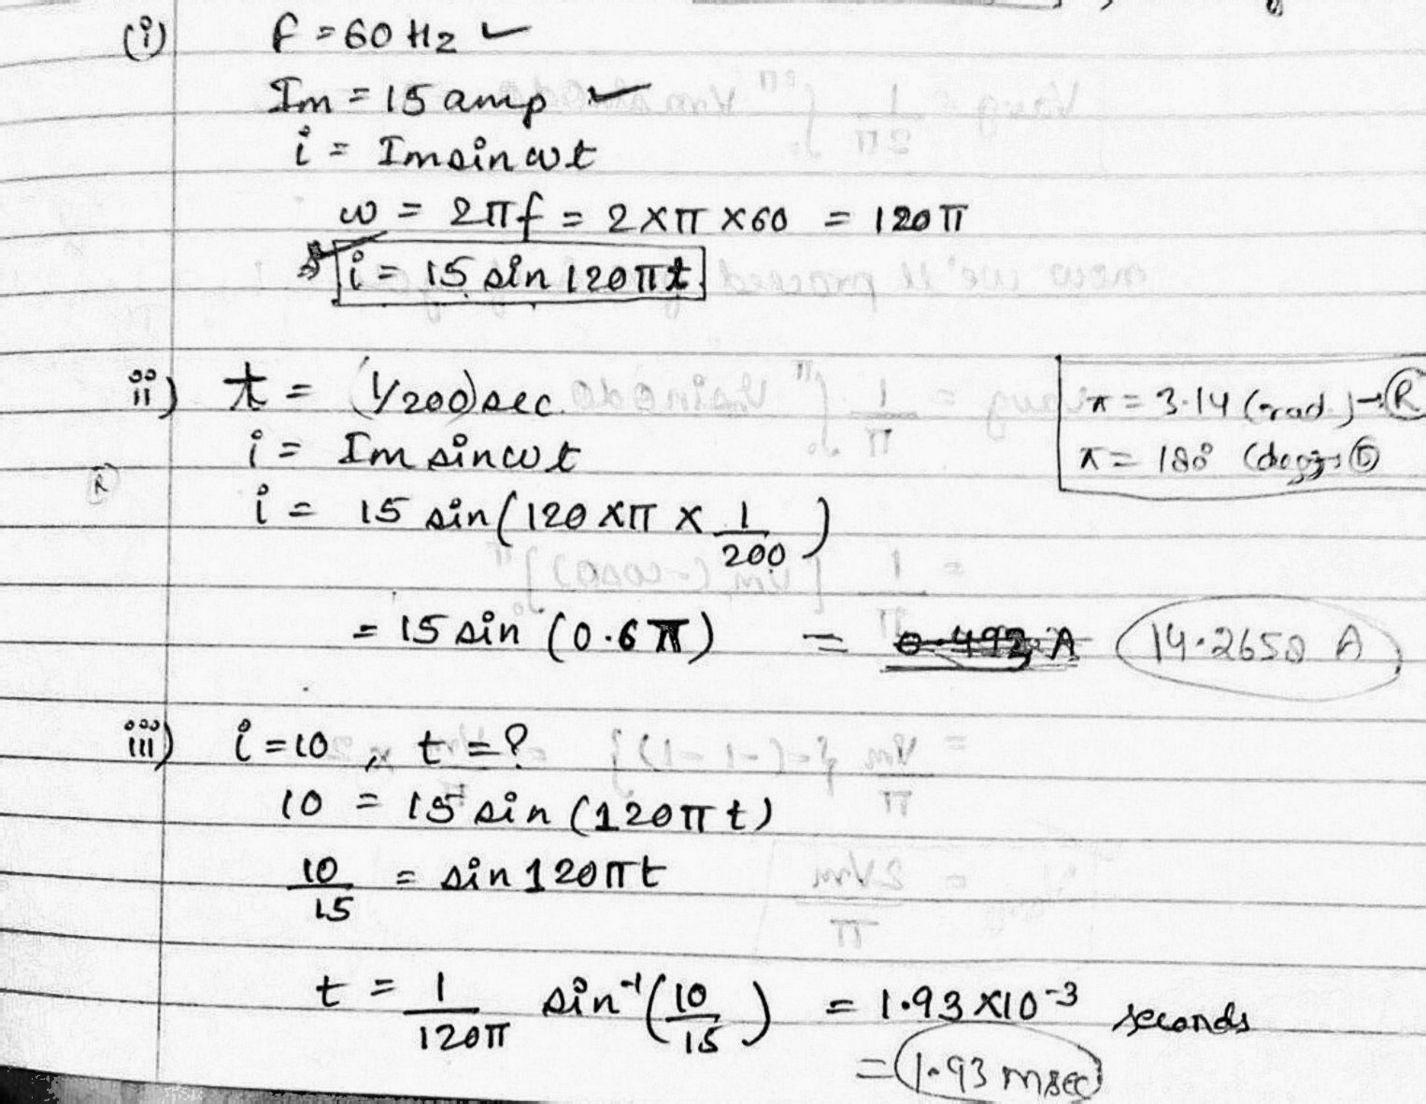
AC fundamentals (CO2)

Slide 8
AC Fundamentals (CO2)
Average or mean value:
The average value of an alternating quantity is expressed by that steady current which transfers across any circuit the same charge as is transferred by that alternating current during same time.

Slide 9
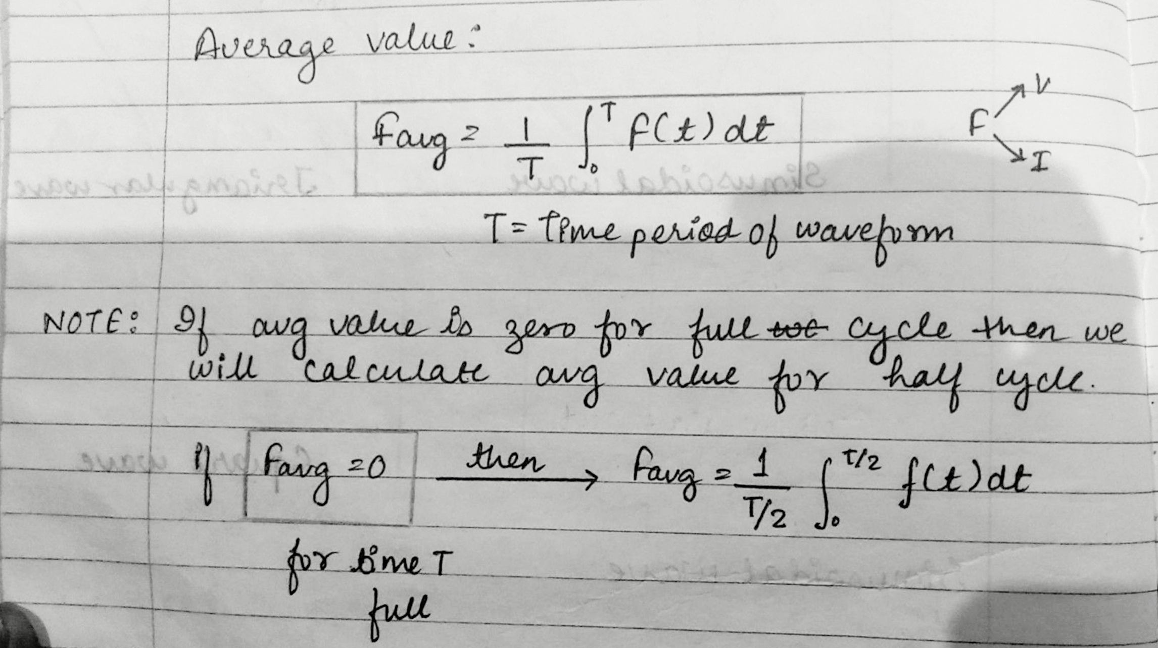
AC Fundamentals (CO2)

Slide 10
AC fundamentals (CO2)
RMS or root mean square value:
The RMS is given by that direct current or voltage which, when flows or applied to a given resistance for a certain time, produces same heat as produced by AC current or voltage when flowing through same resistance for same time.

Slide 11
AC fundamentals
Form Factor:
The ratio of rms value to its average value is known as Form Factor of waveform. It is denoted by K_{f.}
Form Factor (K_{f}) =
Peak Factor/Crest Factor:
The ratio of maximum value to its rms value is known as Peak Factor of waveform.
Peak Factor (K_{p} ) =
,

Slide 12
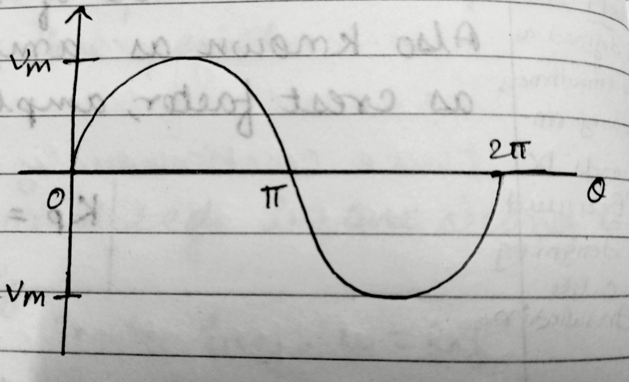
I. Sinusoidal Waveform
Que. Find the following parameters for the sinusoidal waveform:
Average value
RMS value
Form Factor
Peak Factor

Slide 13
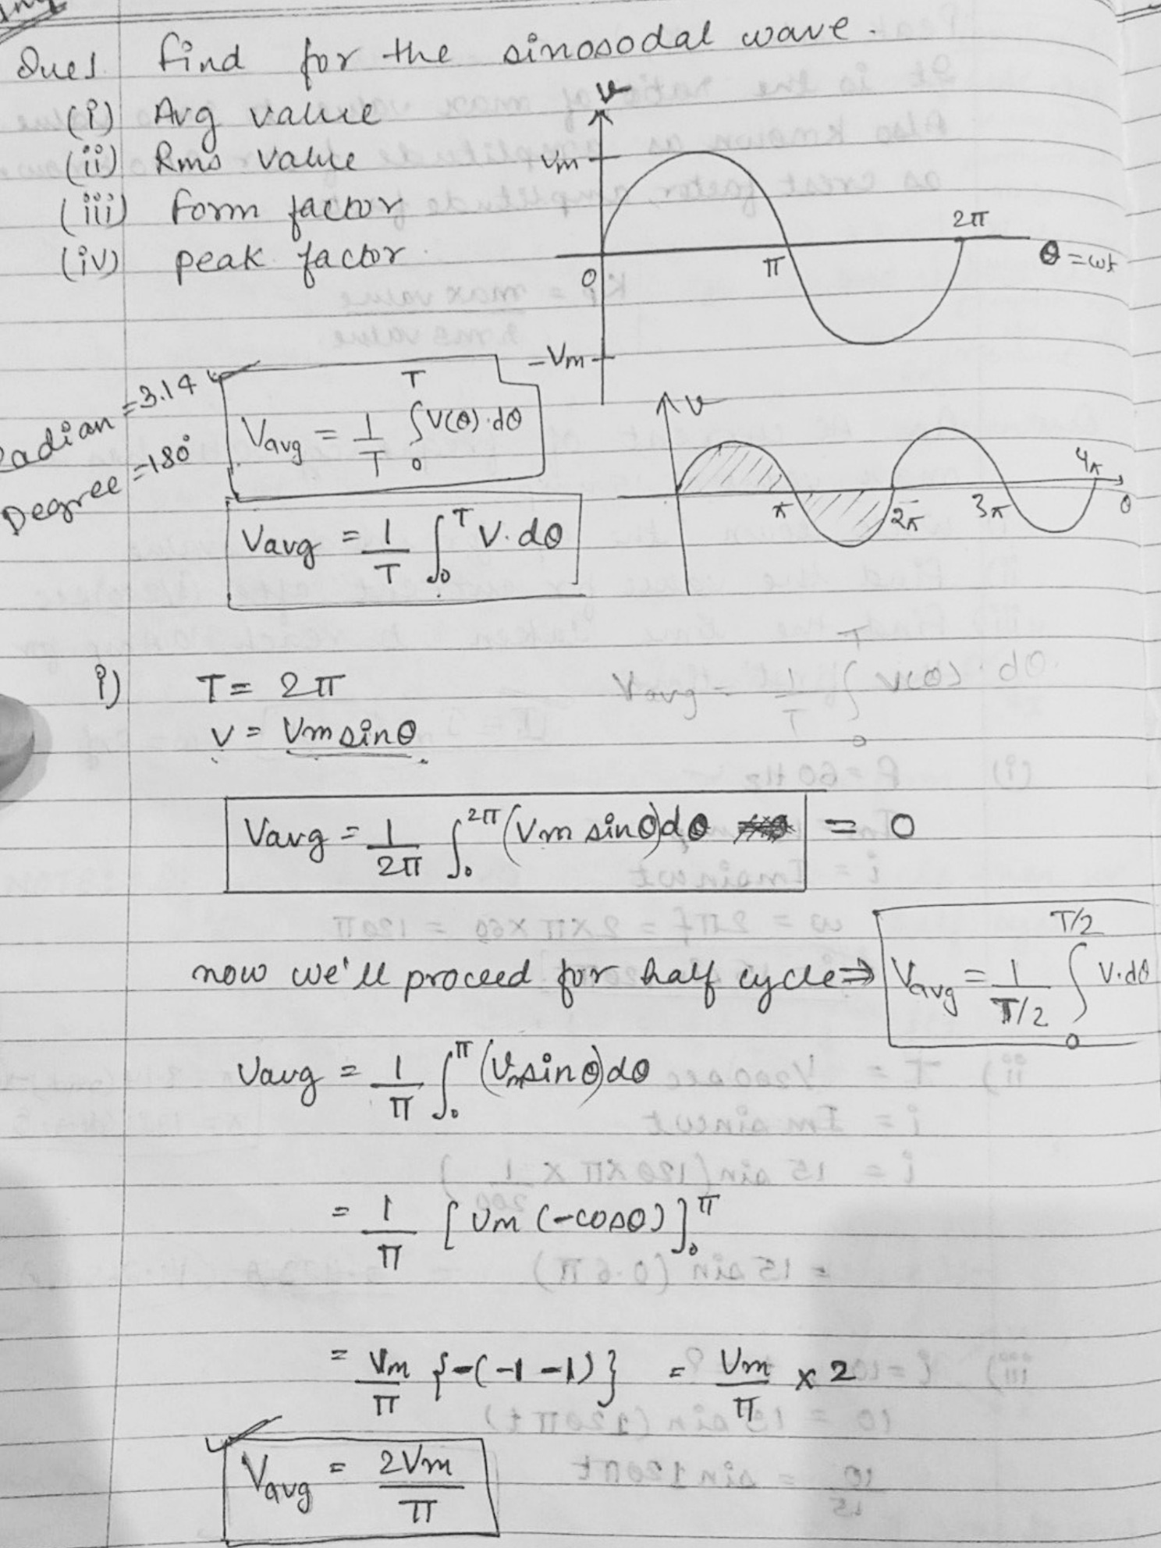
AC fundamentals (CO2)

Slide 14
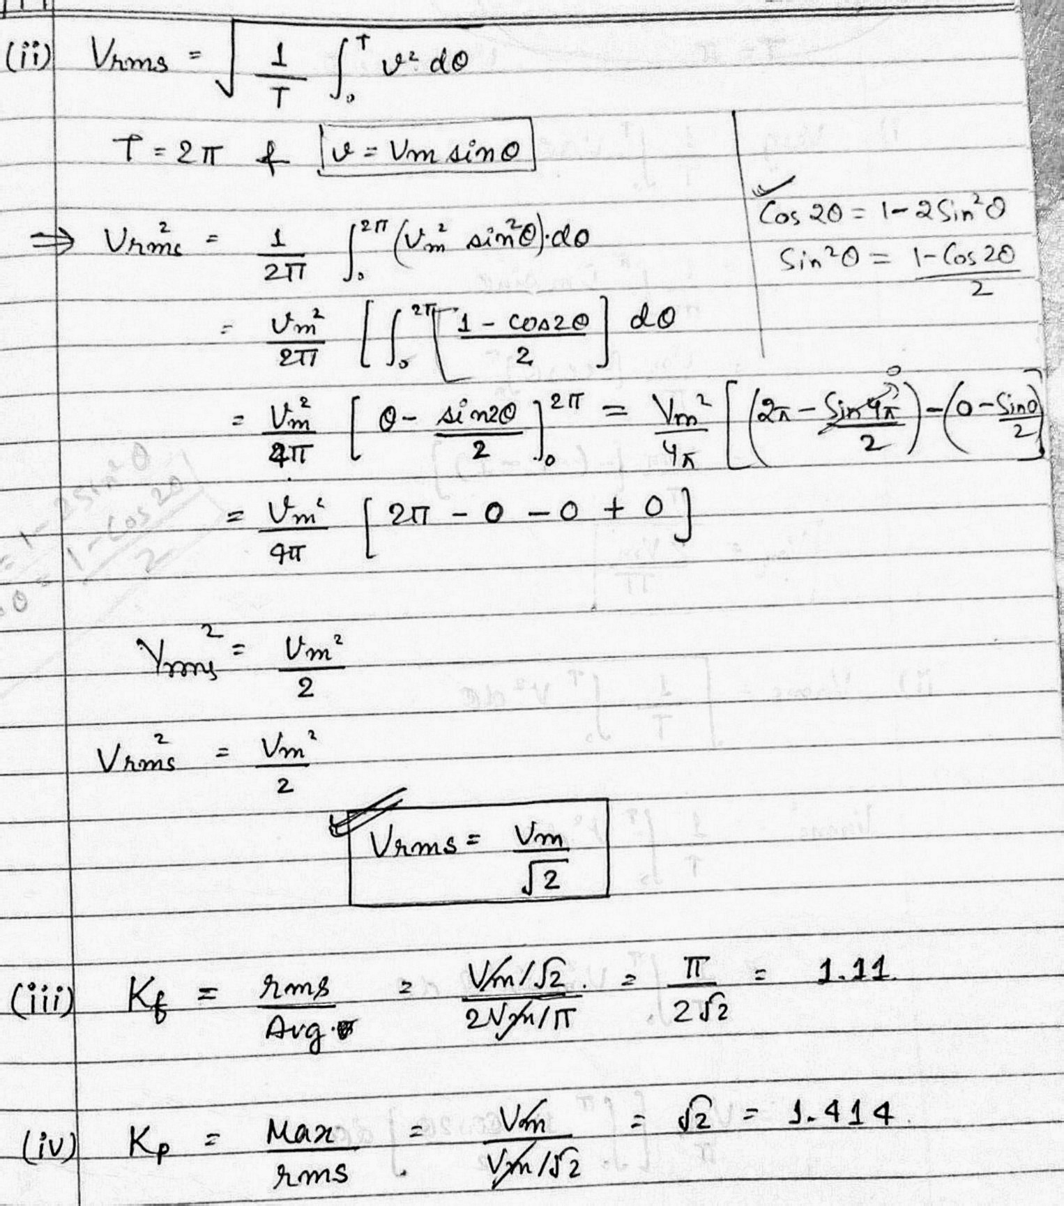
AC fundamentals (CO2)

Slide 15
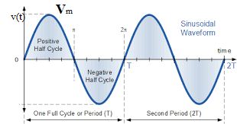
Sinusoidal Waveform
0 to Peak voltage is its Amplitude or Max. value
Avg. value
RMS Value
Form Factor = 1.11
Peak Factor = 1.414

Slide 16
AC fundamentals (CO2)
Que. Find the rms value & frequency for the given equation:
v = 150 sin314t

Slide 17
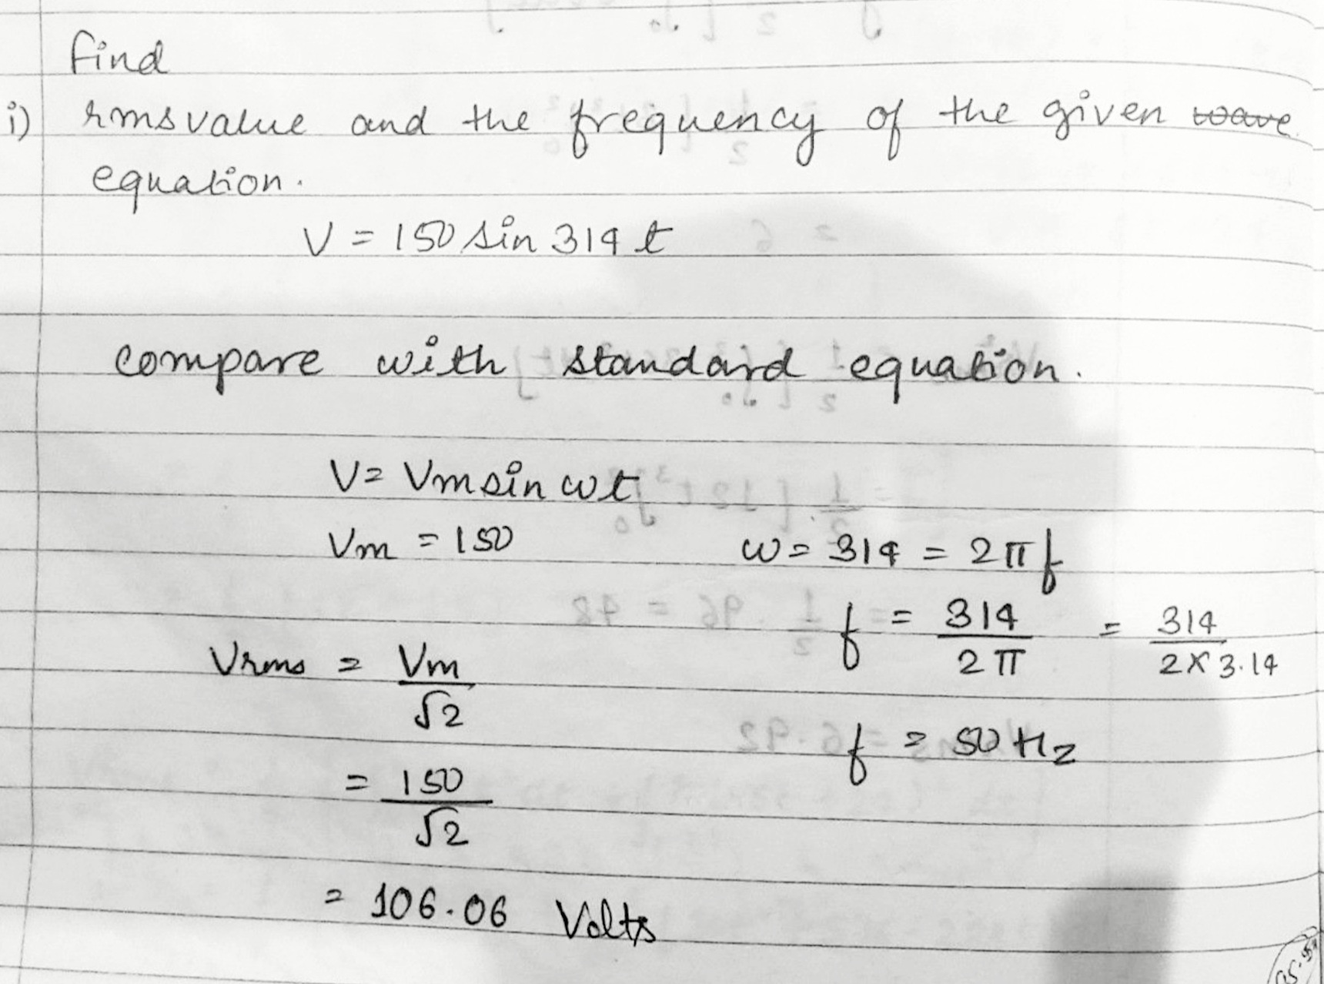
AC fundamentals (CO2)

Slide 18
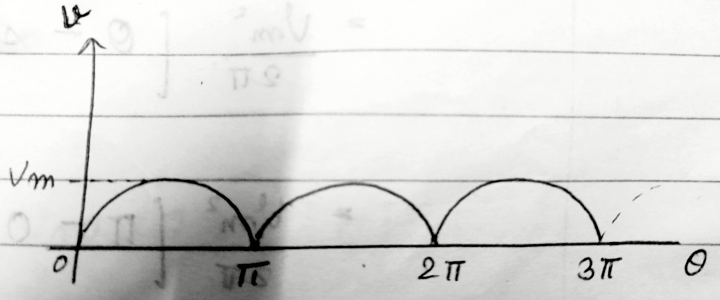
II. Full Wave Rectifier
Que. Find the following for the output of full wave rectifier:
Average value
RMS value
Form Factor
Peak Factor

Slide 19
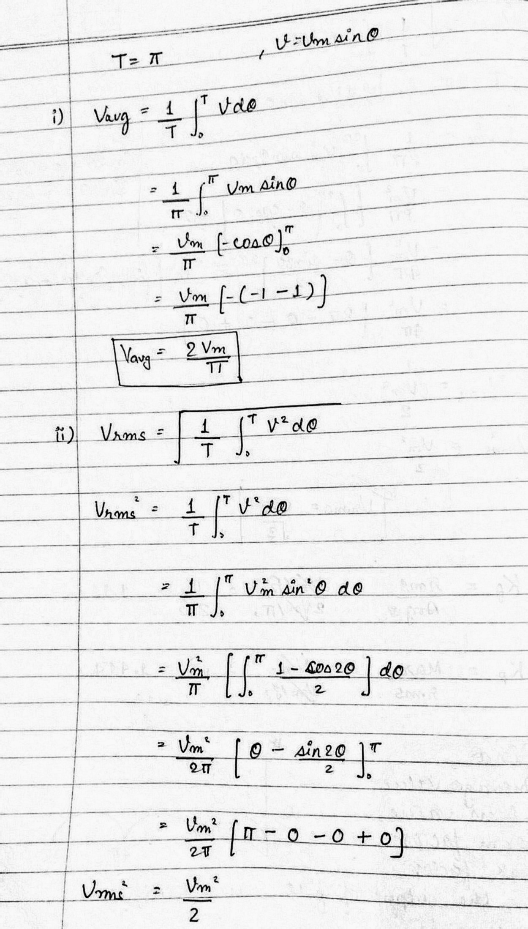
AC fundamentals (CO2)

Slide 20
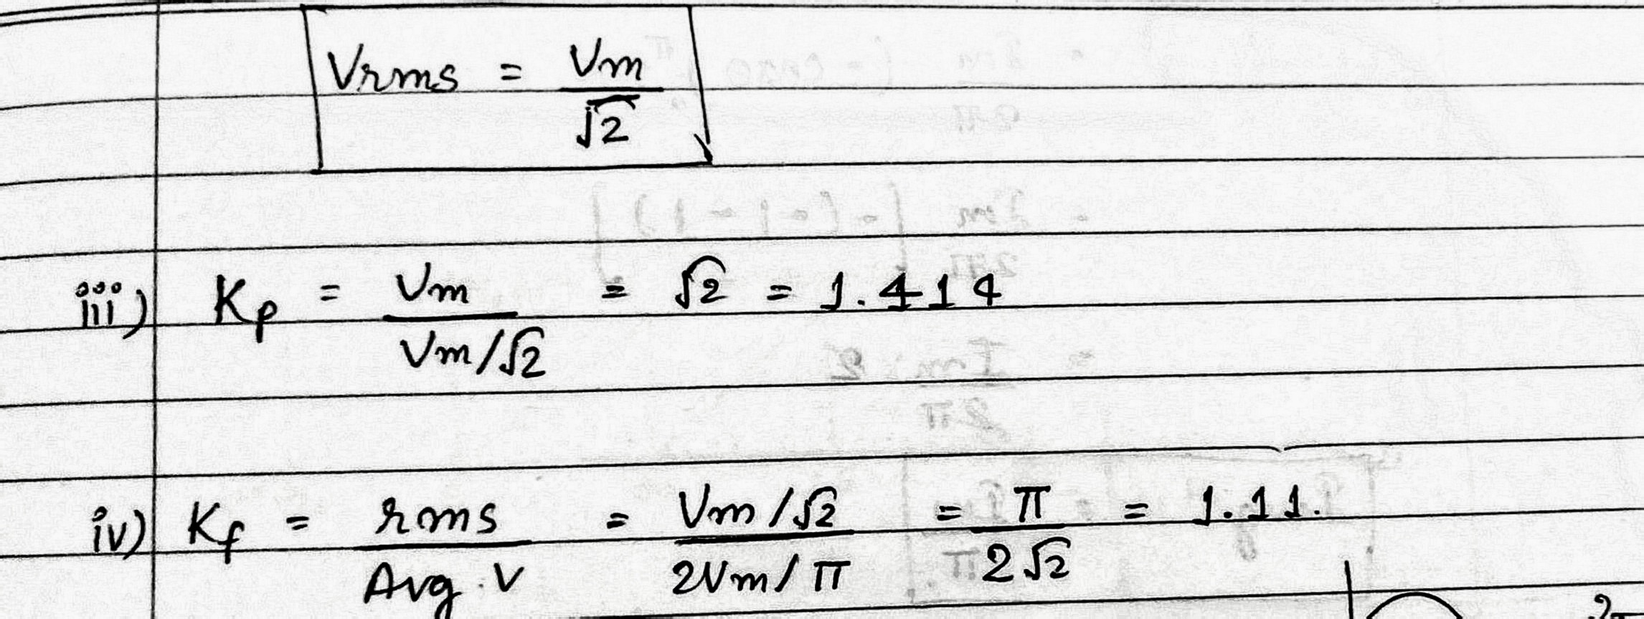
AC fundamentals (CO2)

Slide 21
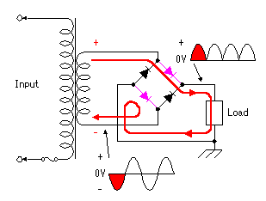
Full wave rectifier output
Form Factor = 1.11
Peak Factor = 1.414

Slide 22
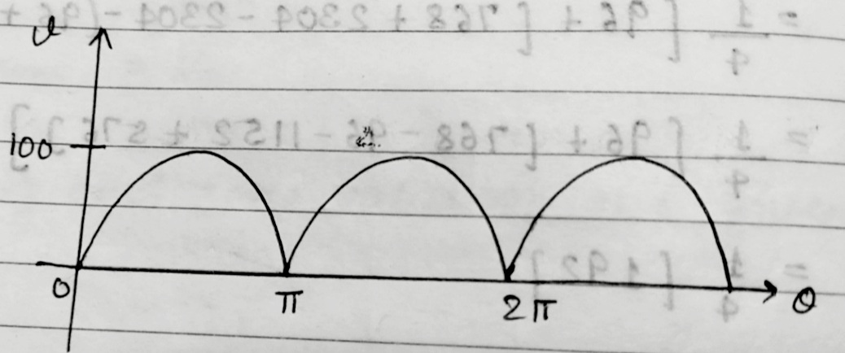
AC fundamentals (CO2)
Que. Find the average value & rms value for the given waveform:

Slide 23
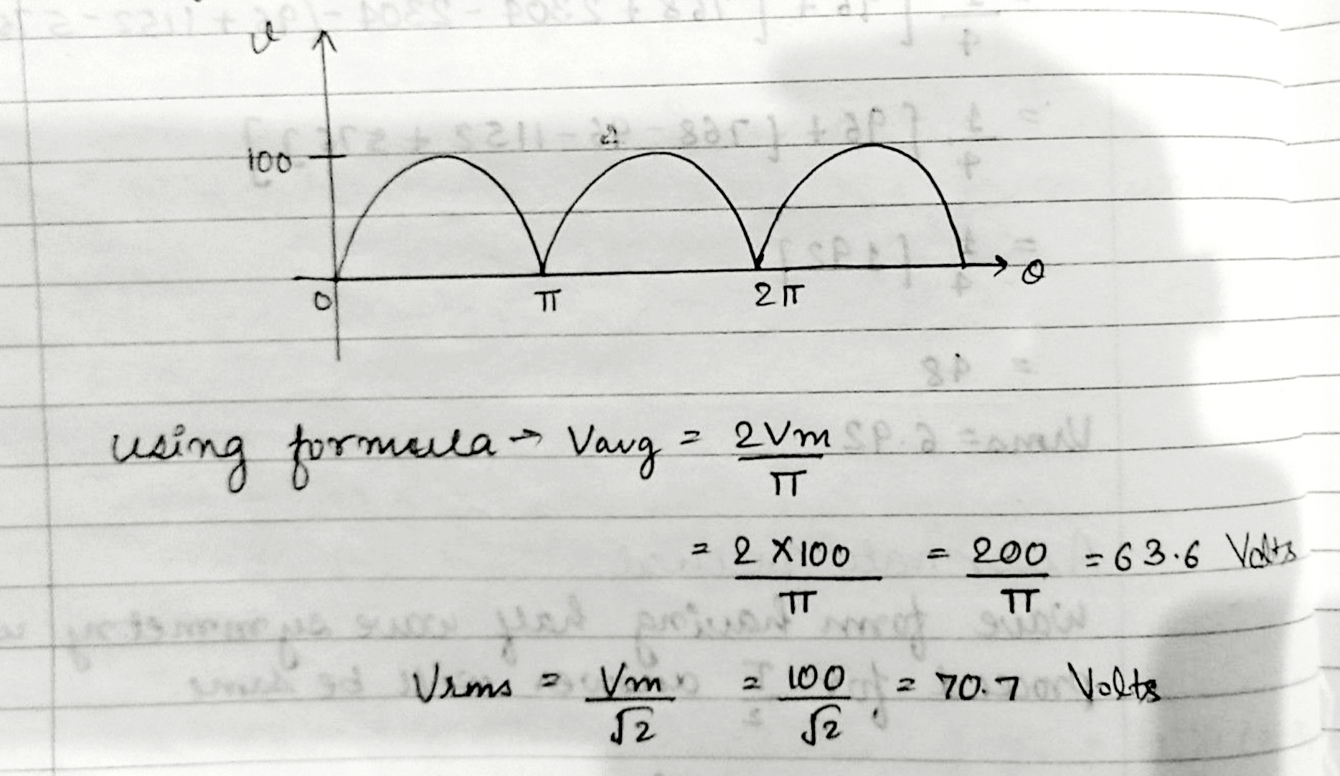
AC fundamentals (CO2)

Slide 24
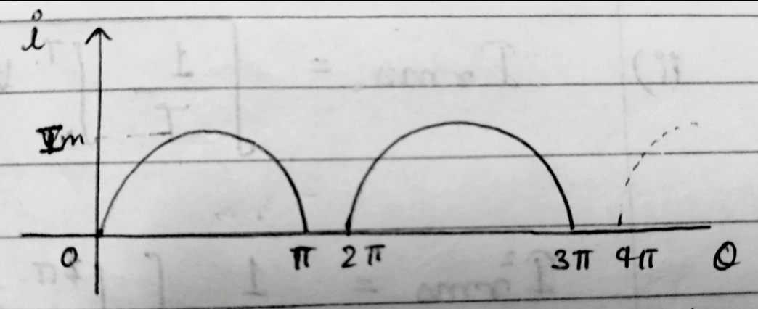
III. Half Wave Rectifier
Que. Find the following for the output of half wave rectifier:
Average value
RMS value
Form Factor
Peak Factor

Slide 25
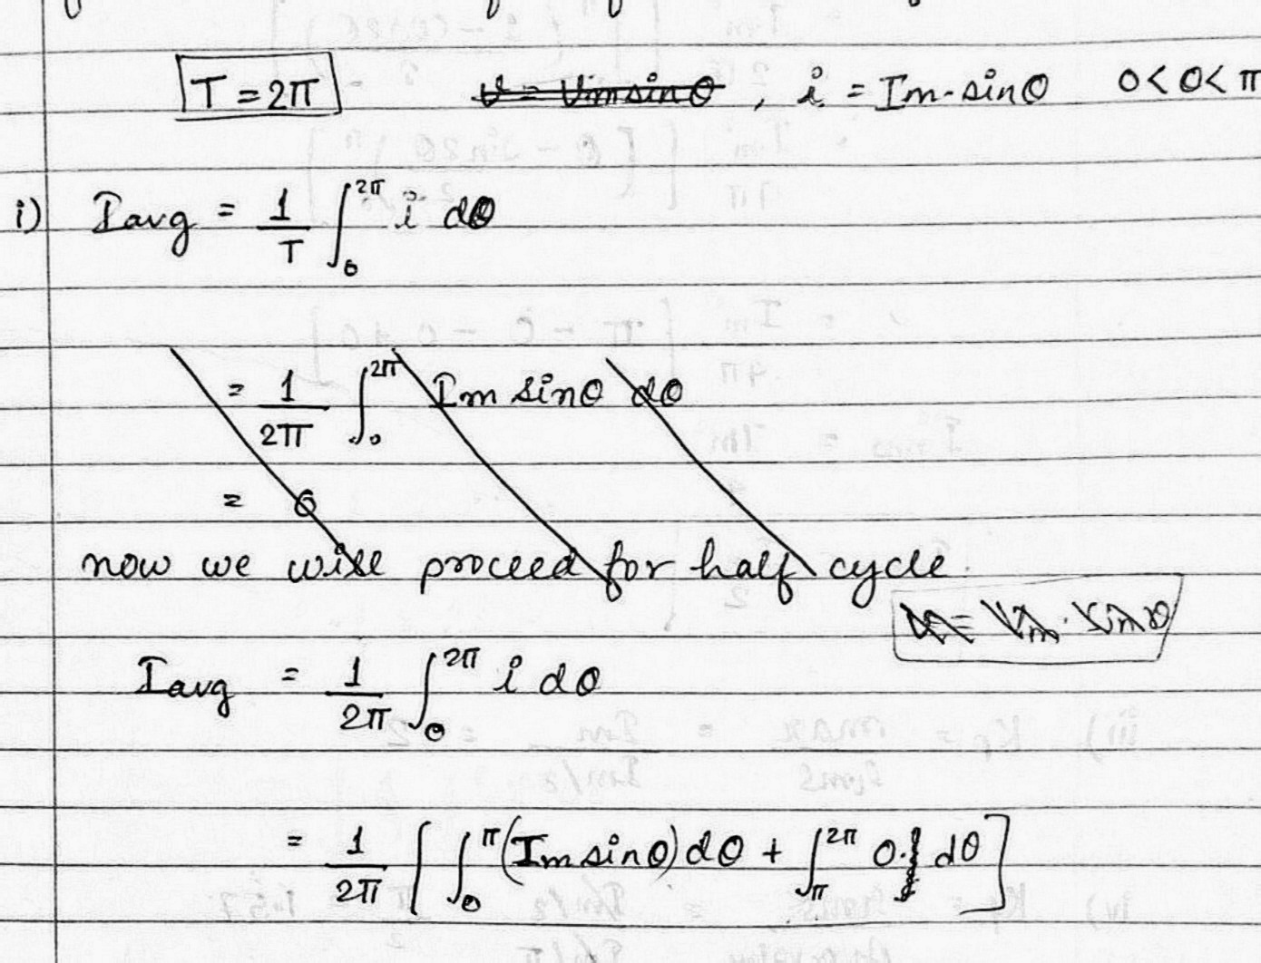
AC fundamentals (CO2)

Slide 26
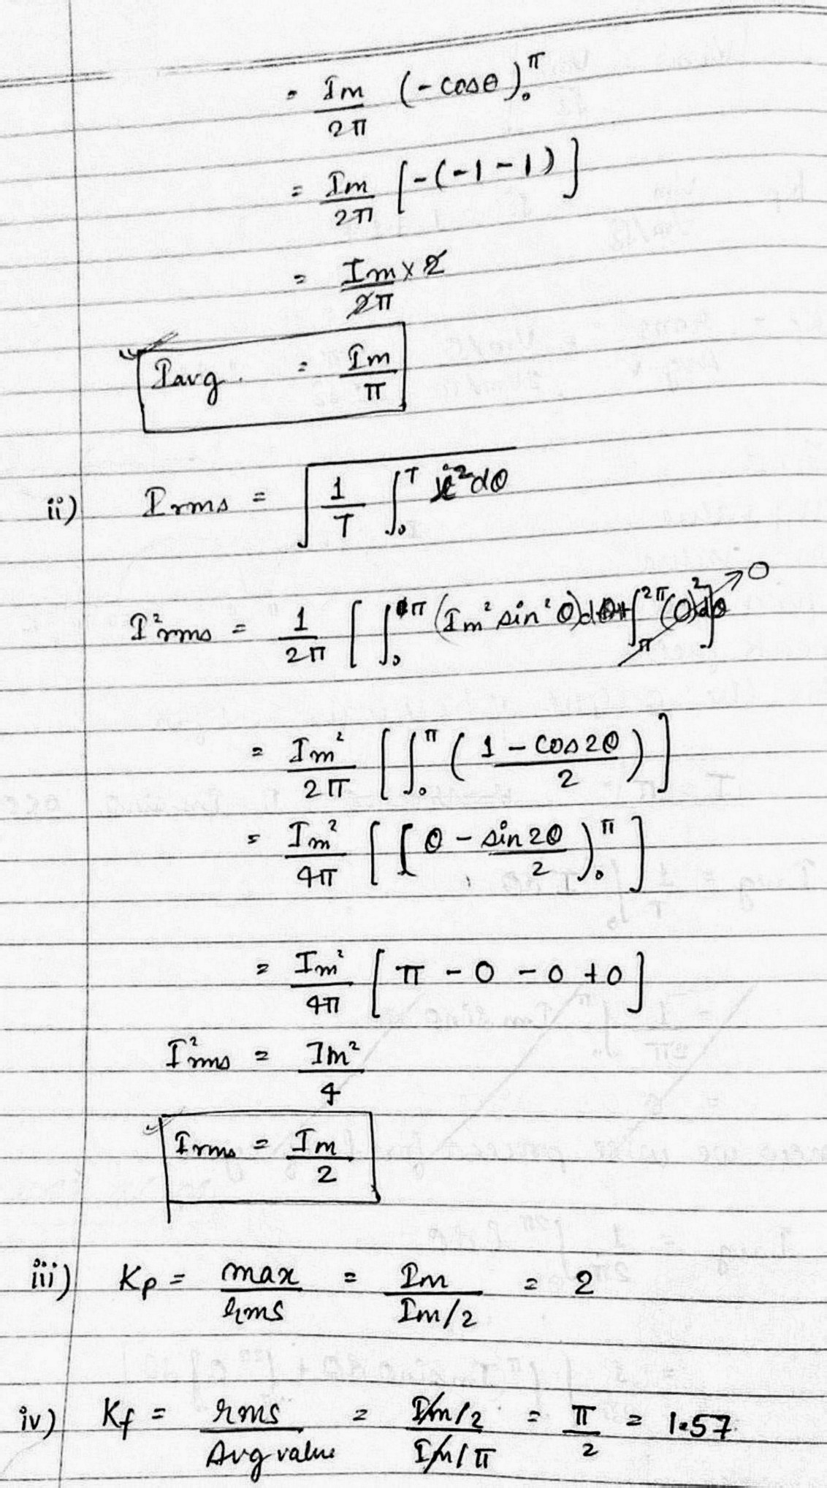
AC fundamentals (CO2)

Slide 27
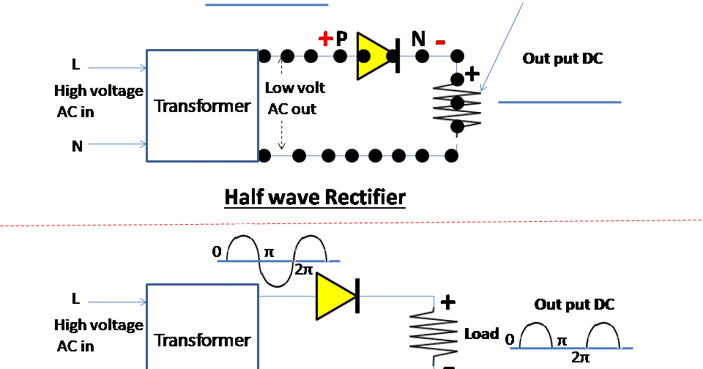
Half wave rectifier output (CO2)
Form Factor = 1.57
Peak Factor = 2

Slide 28
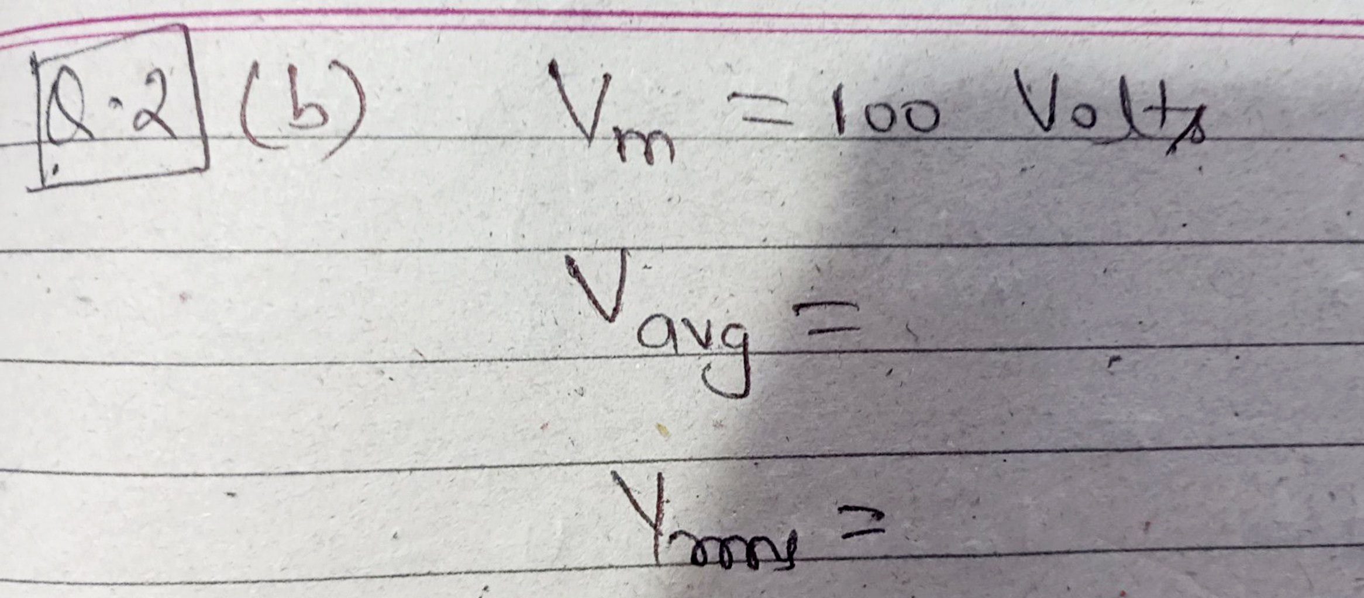
Assignment Questions

Slide 29
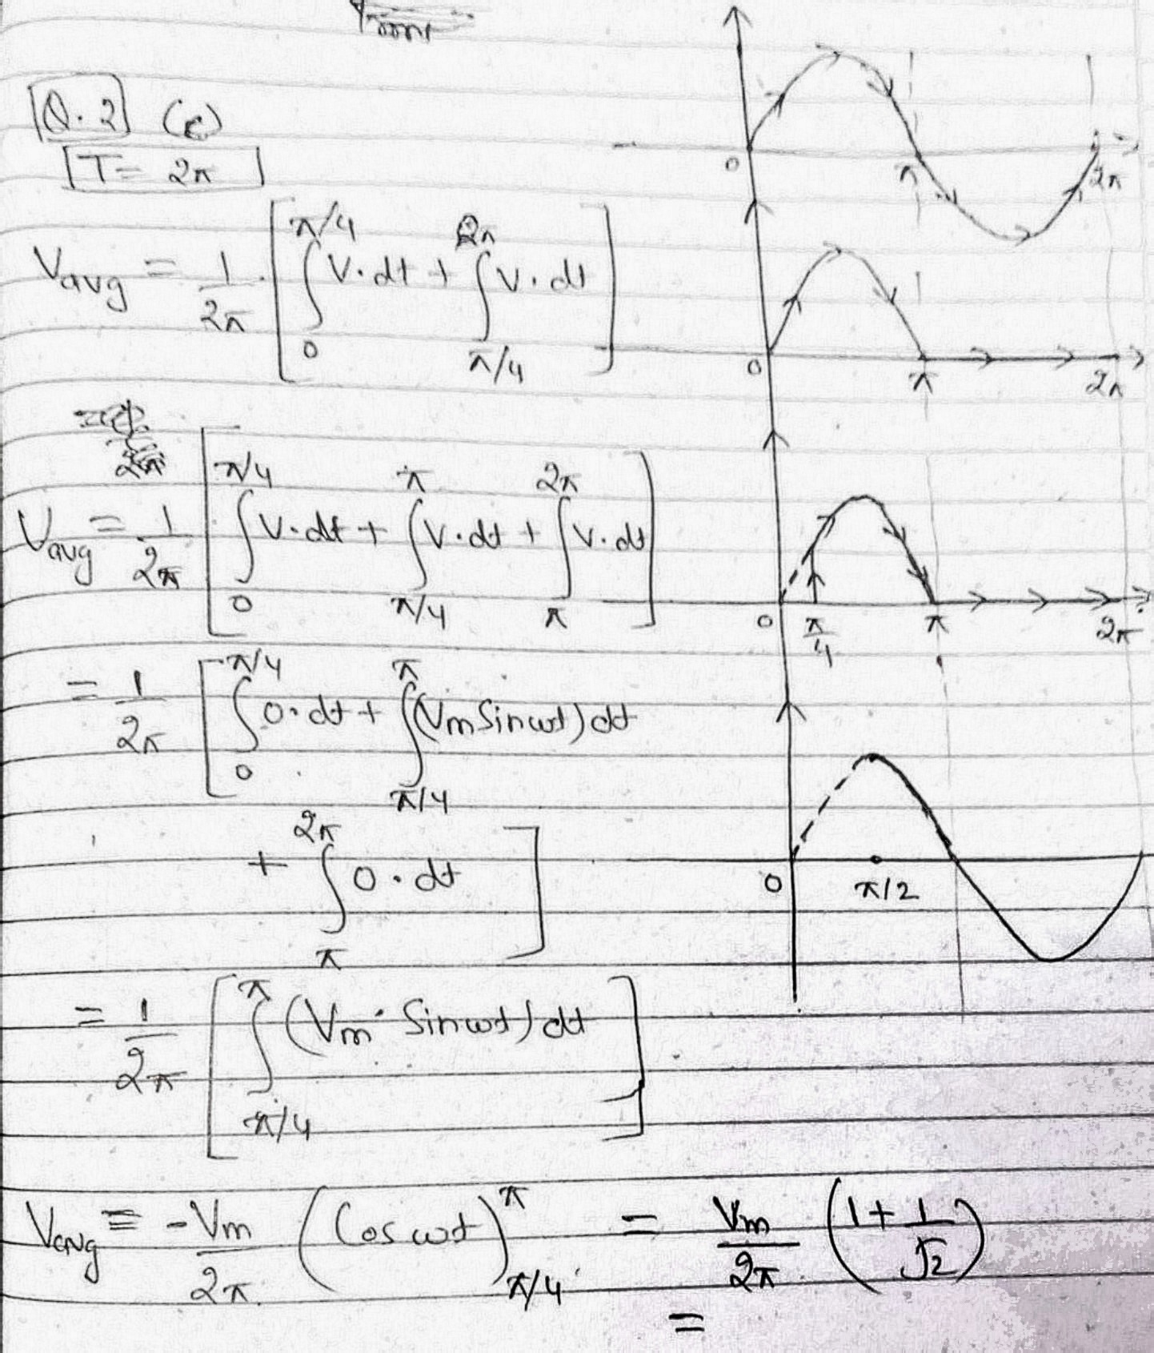
Assignment Questions

Slide 30
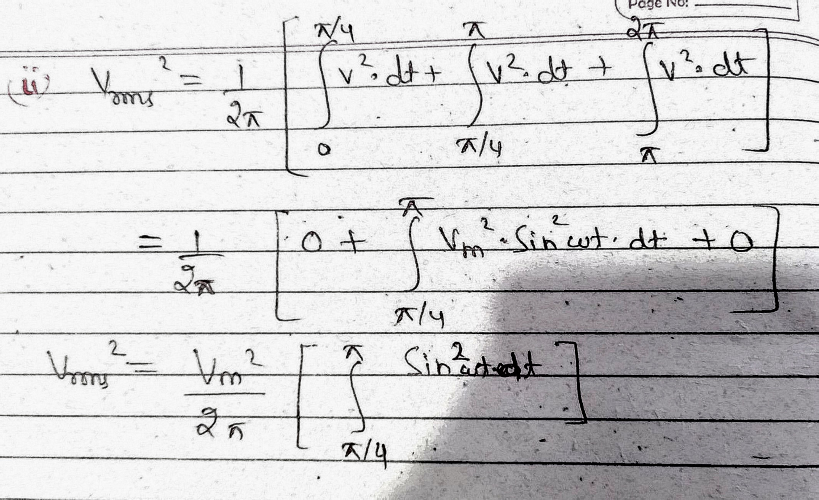
Assignment Questions

Slide 31
Area Method for Calculation of Average Value
Average Value = Area of wave over a time period
Time Period

Slide 32
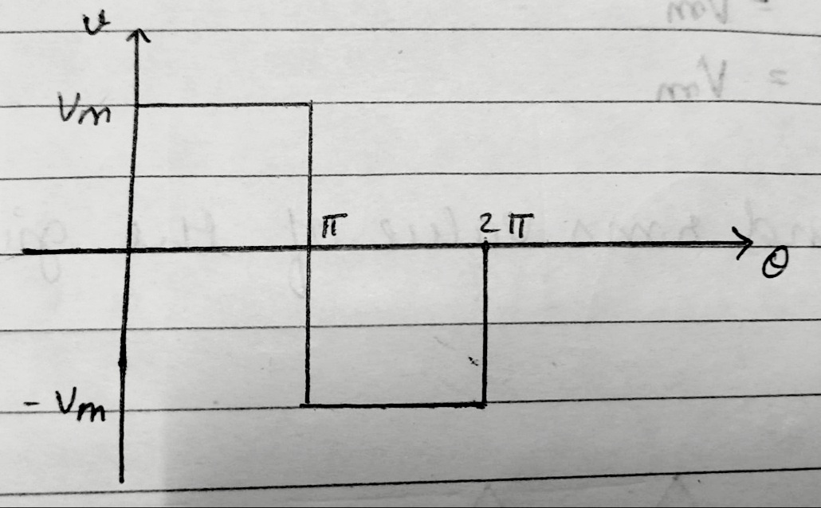
IV. Square Wave
Que. Find the average value & rms value for the given waveform:

Slide 33
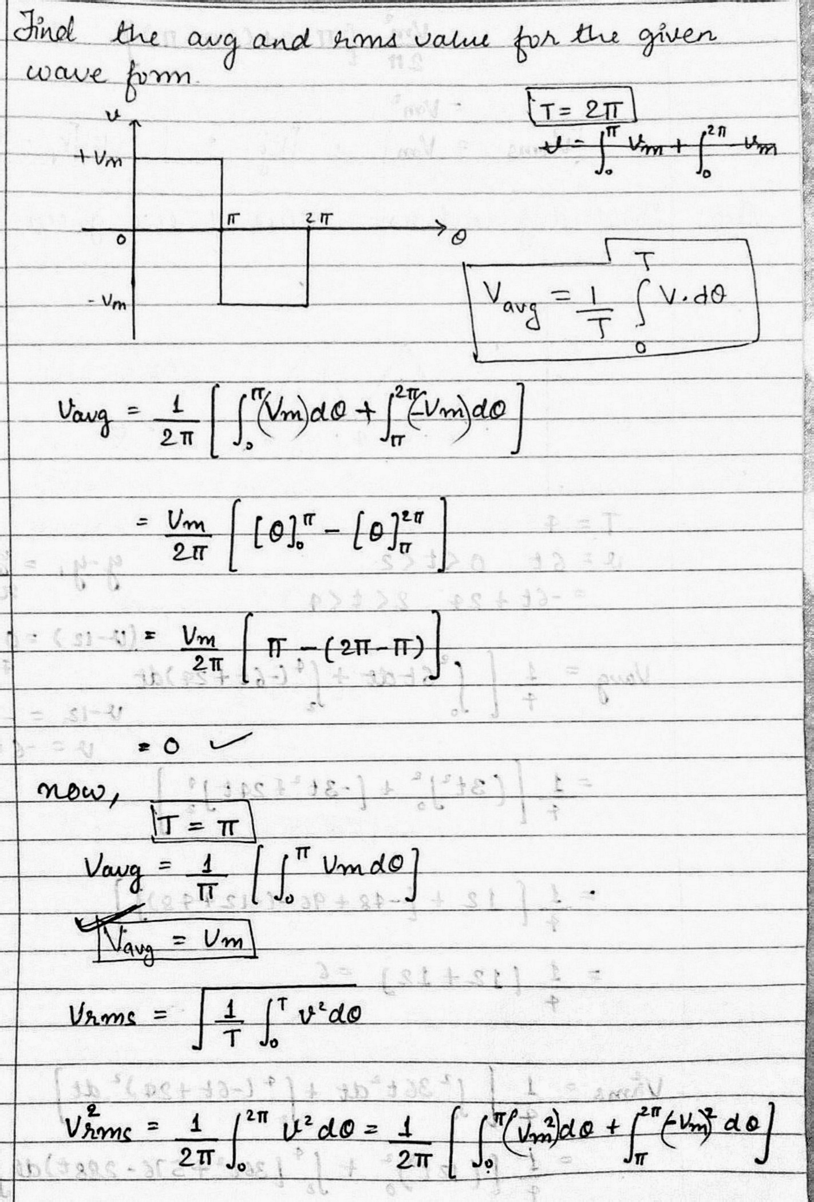
AC fundamentals (CO2)

Slide 34
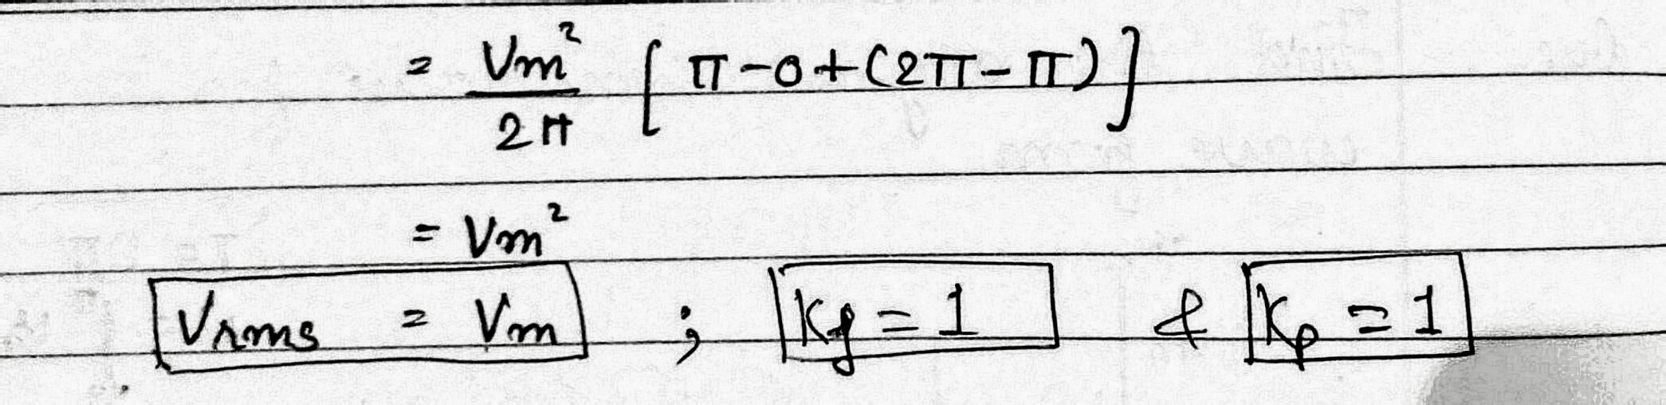
AC fundamentals (CO2)

Slide 35
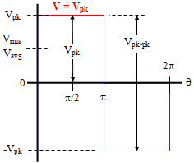
Square waveform (CO2)
Can be calculated in digital form
Avg. Value
RMS Value
Form Factor = 1
Peak Factor = 1

Slide 36
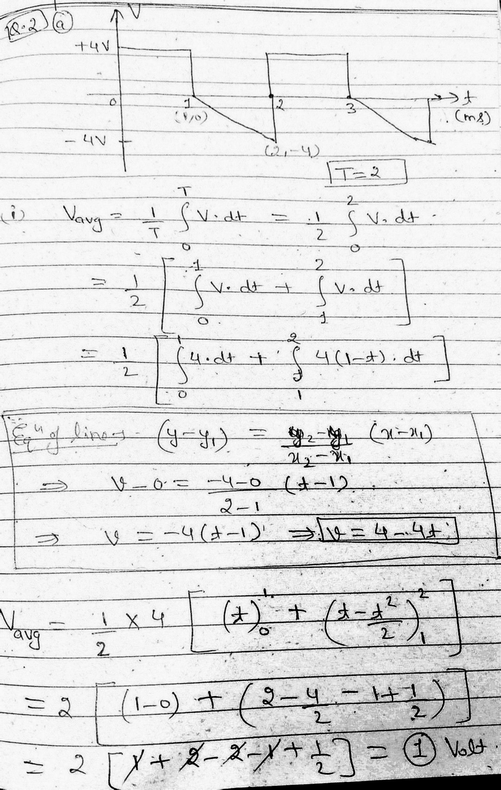
Assignment Questions

Slide 37
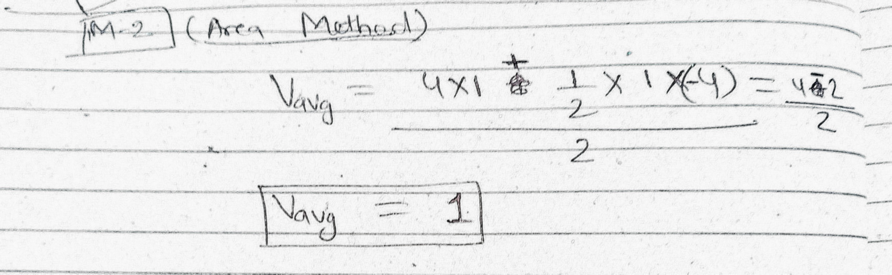

AC fundamentals (CO2)

Slide 38
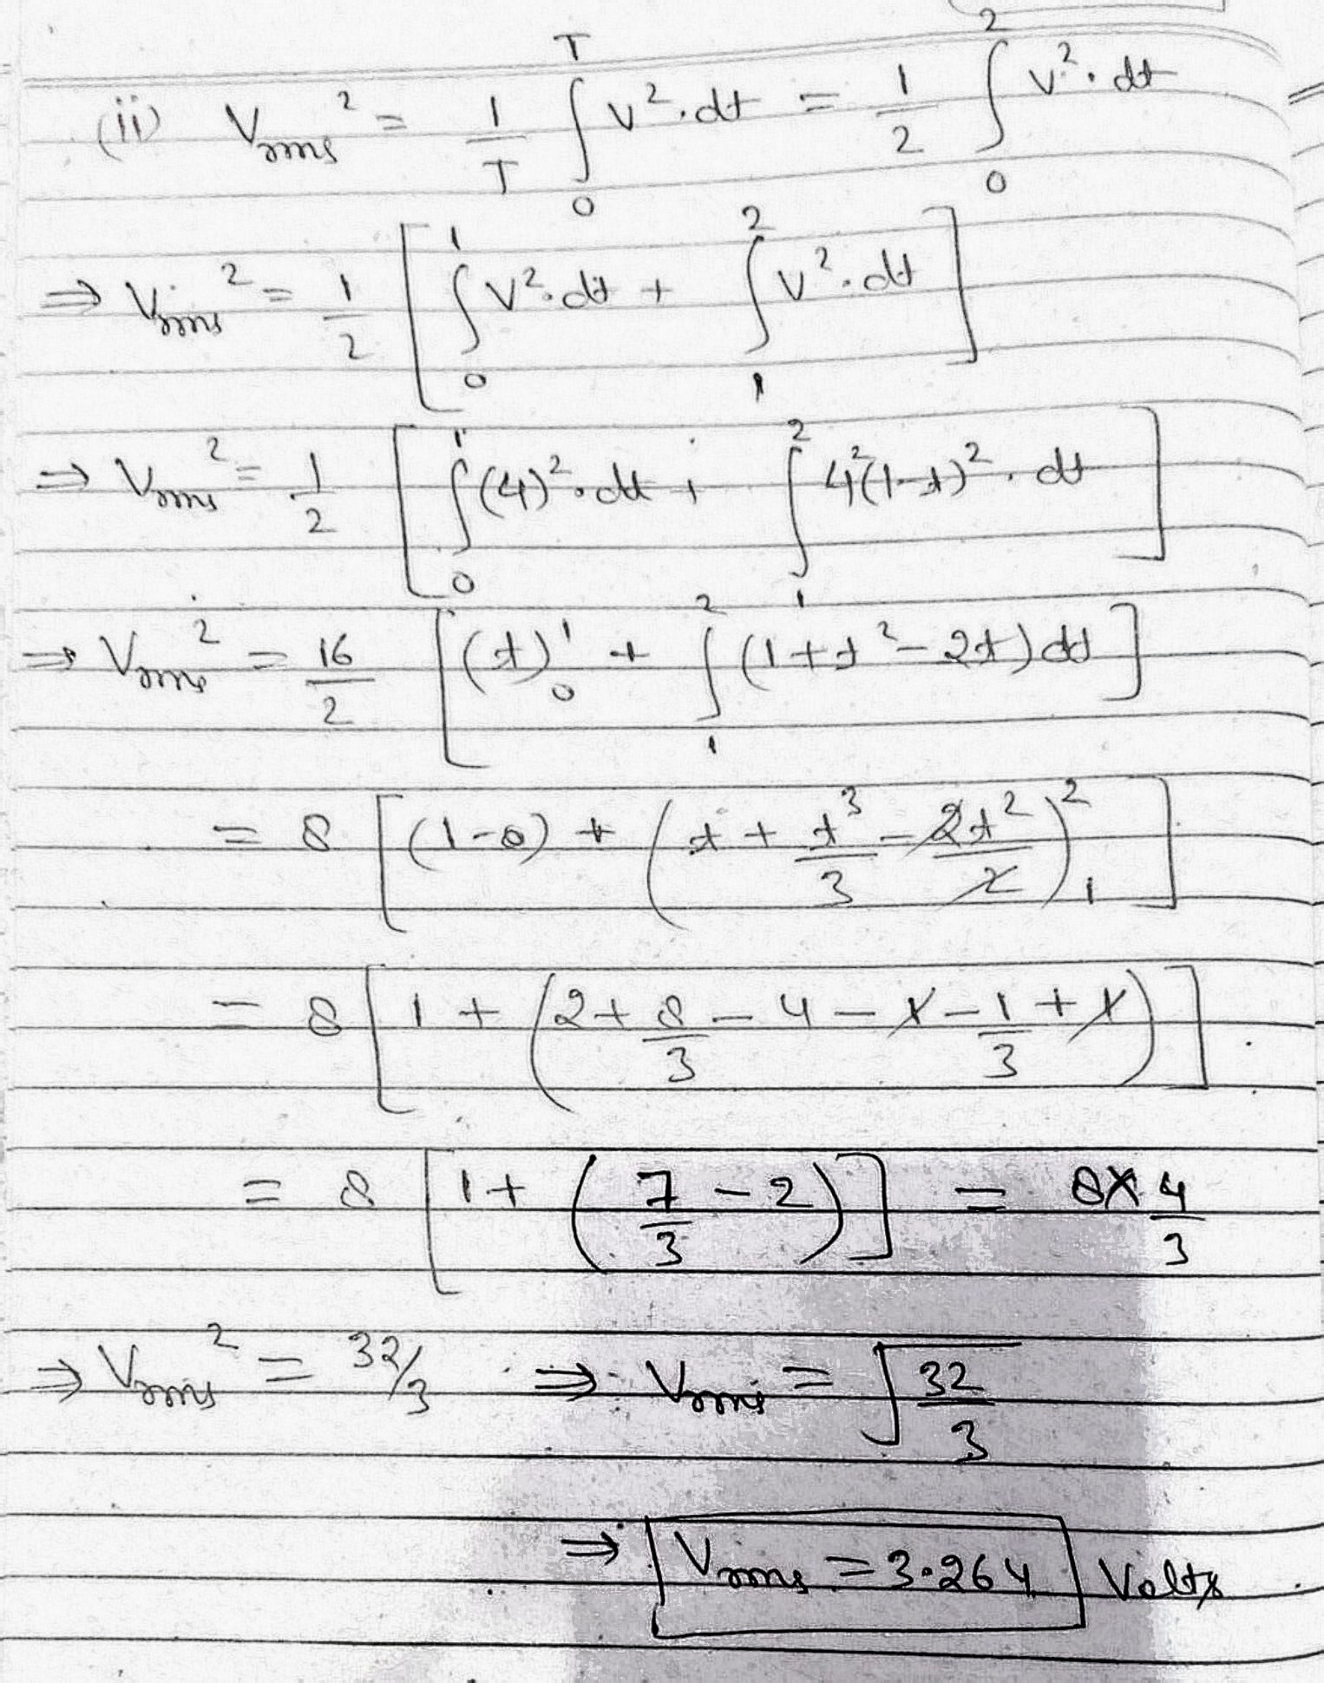
Assignment Questions

Slide 39
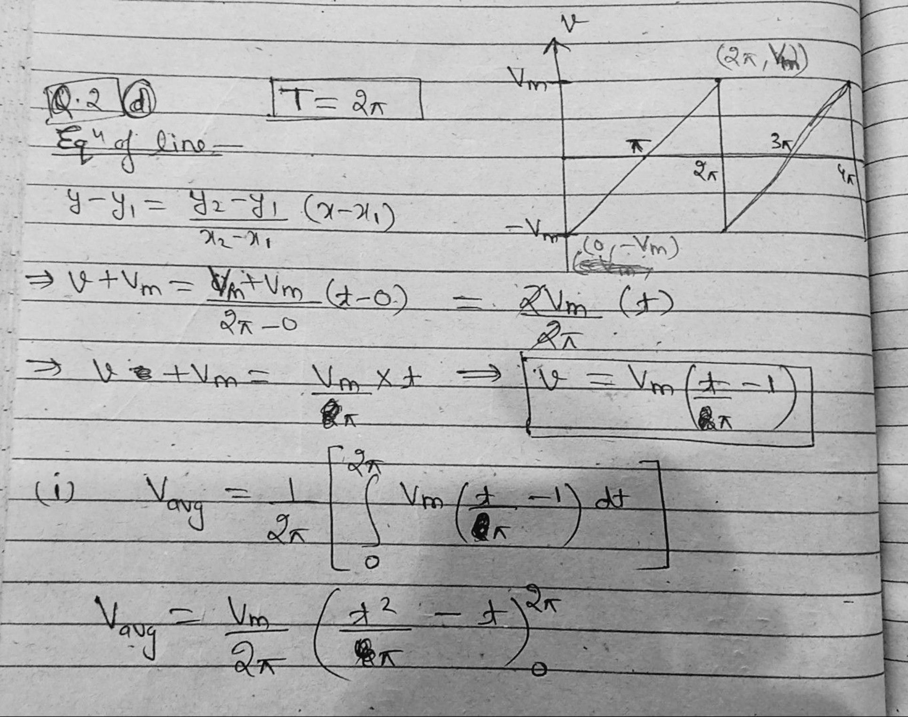
AC fundamentals (CO2)

Slide 40
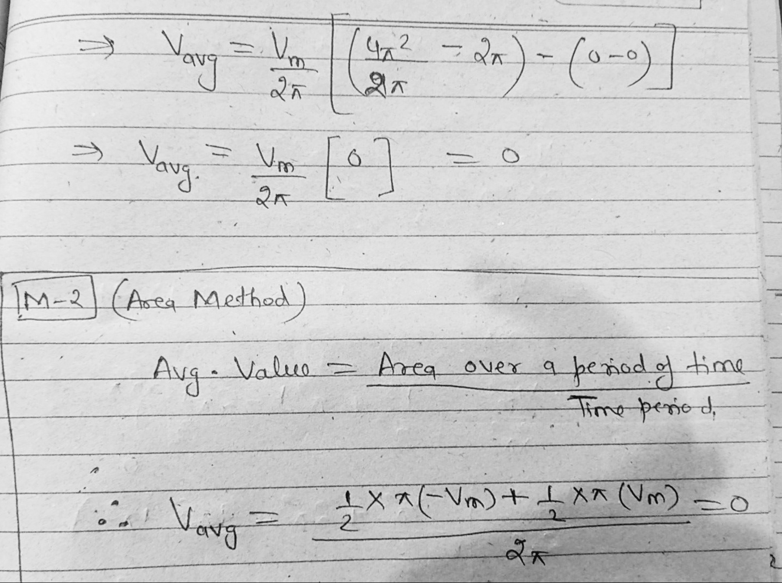
AC fundamentals (CO2)

Slide 41
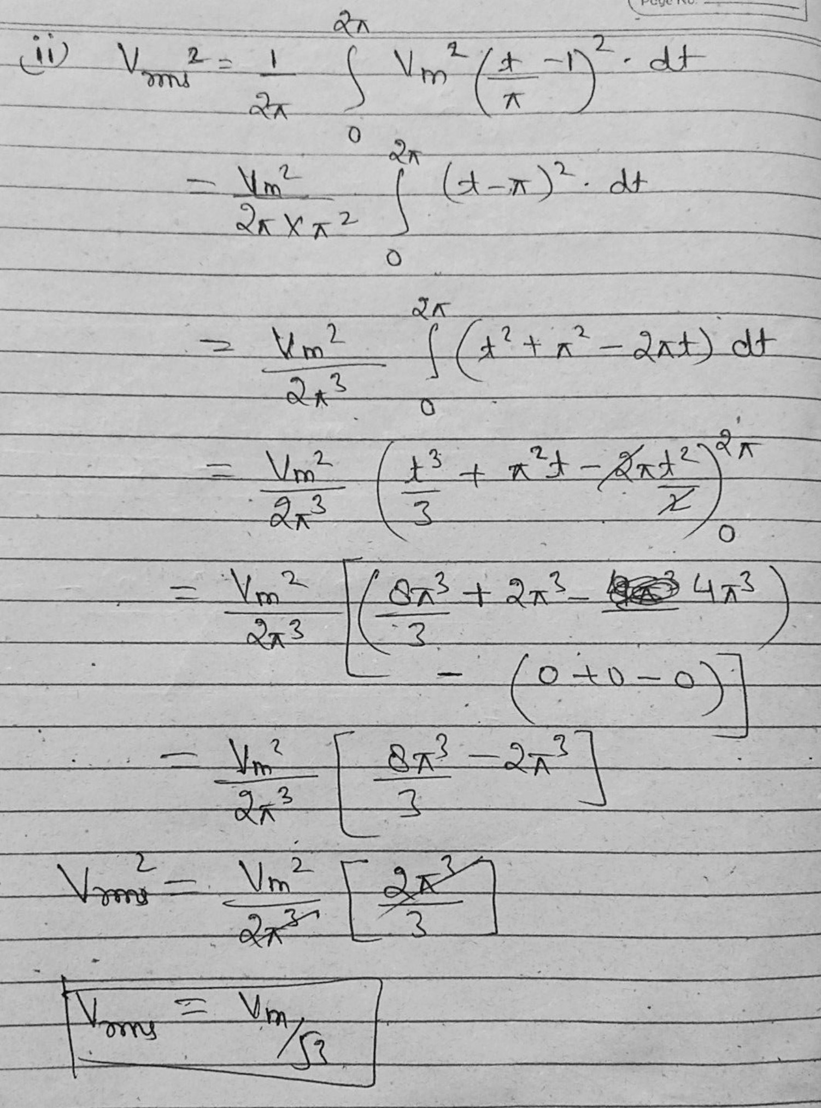
AC fundamentals (CO2)

Slide 42
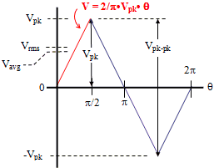
V. Triangular Waveform
Que. Find the following for the given waveform:
Average value
RMS value
Form Factor
Peak Factor

Slide 43
Triangular waveform (CO2)
Function formed by Line Equation
Avg. Value
RMS Value
Form Factor = 1.15
Peak Factor = 1.732

Slide 44
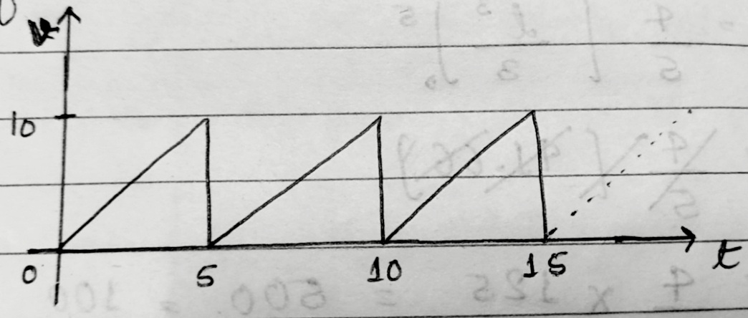
AC fundamentals (CO2)
Que. Find the average value & rms value for the given waveform:

Slide 45
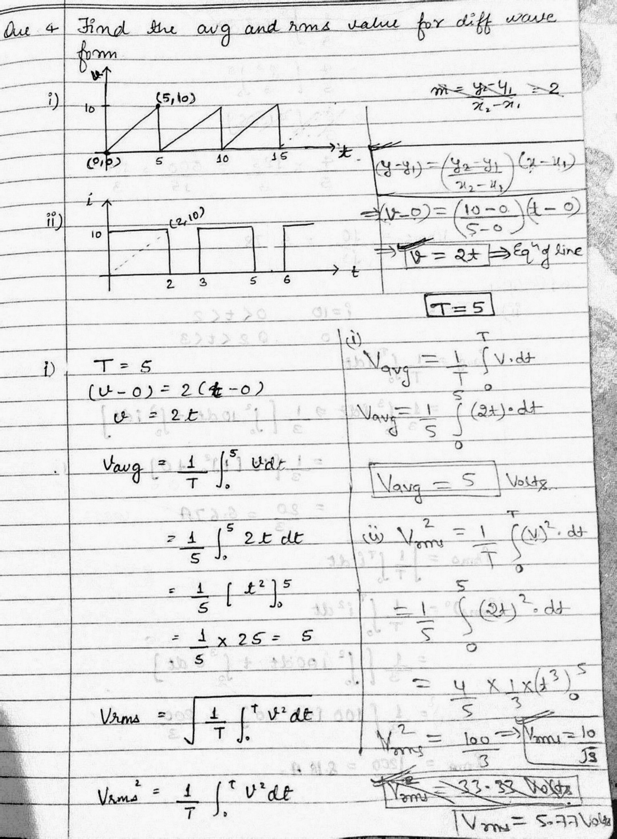
AC fundamentals (CO2)

Slide 46
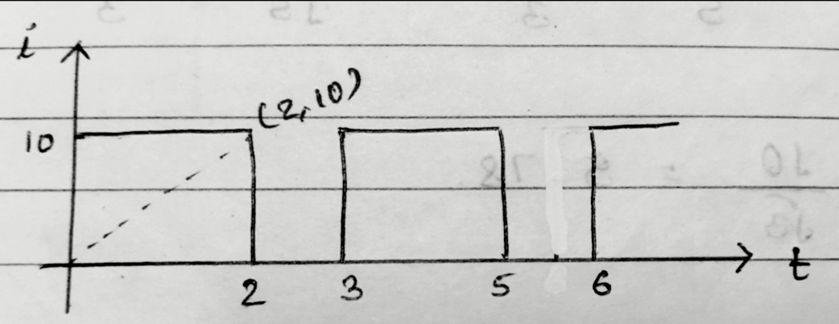
AC fundamentals (CO2)
Que. Find the average value & rms value for the given waveform:

Slide 47
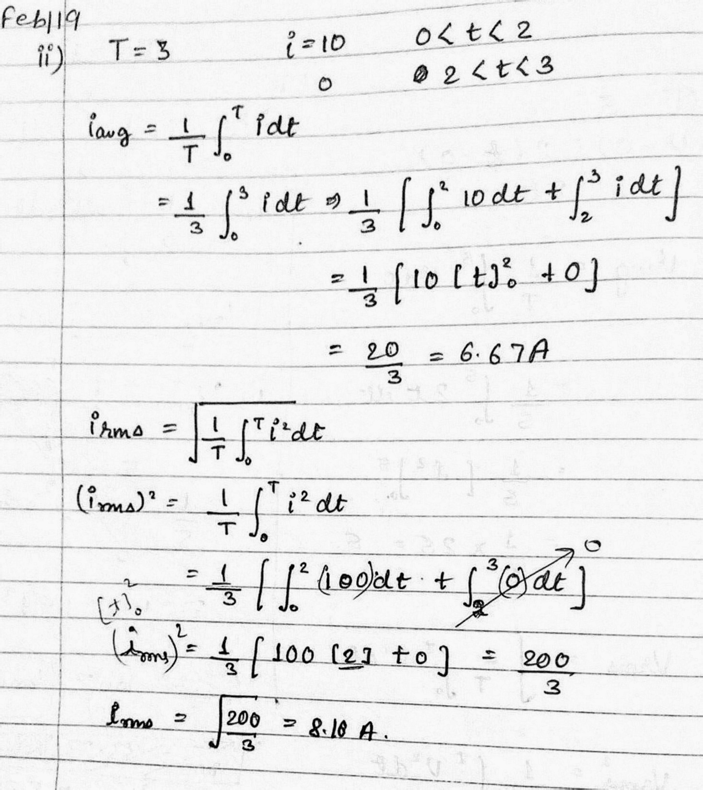
AC fundamentals (CO2)

Slide 48
MCQ
Q.1. What is the time period of 50 Hz AC wave form
50 msec. b) 0.02 sec. c) 0.02 msec. d) 2 msec.
Q.2. What is the form factor of Triangular Waveform
1.15 b) 1.25 c)5.11 d) 2.15
Q.3. RMS value of AC waveform is ……….. time of maximum value
a) 1.414 b) 0.707 c) 1 d) 1.732
Answers: Q.1. (b) 0.02 sec. Q.2. (a) 1.15 Q.3. (b) 0.707

Slide 49
Weekly Assignment/
Expected Questions for University Exam
Q.1. Find Average Value, RMS value and form factor of half wave rectifier alternating current. (UPTU 2006-2007)
Q.2. An alternating voltage is given by v = 141.4sin314t. Find
(i) Frequency (ii) RMS value (iii)Average Value
(iv) Instantaneous value of voltage when t = 3ms.
(v) the time taken for the voltage to reach 100V after passing through zero value (UPTU 2006-2007,AKTU:2017-18)
Q.3. What is average and effective value, form and peak factors of half wave rectifier voltage ? (UPTU 2012-13)

Slide 50
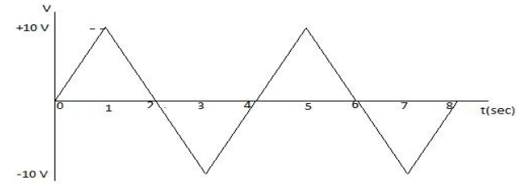
Weekly Assignment/
Expected Questions for University Exam
Q.4 Calculate average value , rms value , form factor and peak factor of
the following waveform shown in figure [AKTU:2017-18]

